Slide 1
Session 11
Introduction to Spring ,
Spring Boot,
Spring MVC

Slide 2
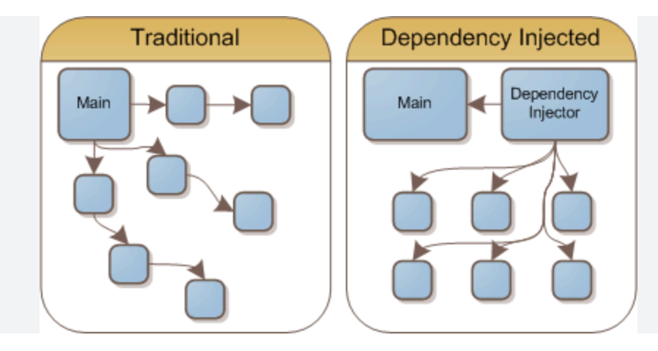
1: Introduction to Spring Framework
1.1 What is Spring? - Explanation of the Spring Framework. - Benefits of using Spring for Java applications. 1.2 Spring Modules - Overview of core Spring modules (e.g., Spring Core, Spring MVC, Spring Boot). - Role and purpose of each module.

Slide 3
2: Setting Up a Spring Boot Project
2.1 Installation and Project Setup - Installing Spring Boot. - Creating a new Spring Boot project using Spring Initializer. 2.2 Project Structure - Understanding the default project structure. - Key files and directories in a Spring Boot project.

Slide 4
3: Spring Boot Basics
3.1 Spring Boot Configuration - Exploring application properties and configuration. 3.2 Spring Boot Auto-Configuration - How Spring Boot automatically configures beans and components. 3.3 Running a Spring Boot Application - Running a Spring Boot application as a standalone Java application.

Slide 5
4: Introduction to Spring MVC
4.1 What is Spring MVC? - Overview of the Spring MVC framework. - Role of Spring MVC in building web applications. 4.2 MVC Architecture - Understanding the Model-View-Controller (MVC) pattern. - How Spring MVC implements MVC.

Slide 6
5: Building a Simple Spring MVC Application
5.1 Creating Controllers - Writing controller classes to handle HTTP requests. 5.2 Creating Views - Implementing views using JSP or Thymeleaf templates. 5.3 Handling Requests and Responses - Mapping URLs to controller methods. - Handling request parameters and generating responses.

Slide 7
6: Request Mapping and URL Patterns
6.1 Request Mapping Annotations - @RequestMapping, @GetMapping, @PostMapping, etc. 6.2 Path Variables - Extracting values from URL path segments.

Slide 8
7: Spring Boot and Spring MVC Integration
7.1 Spring Boot Starter for Spring MVC - Using Spring Boot starters for web applications. 7.2 Configuration and Customization - Customizing Spring Boot's auto-configuration for Spring MVC.

Slide 9
8: Form Handling and Validation
8.1 Handling HTML Forms - Capturing form data in Spring MVC. 8.2 Data Binding - Binding form data to Java objects. 8.3 Validation - Validating user input using Spring's validation framework.

Slide 10
9: Working with RESTful APIs
9.1 RESTful Web Services - Introduction to REST and its principles. 9.2 Building RESTful Controllers - Creating RESTful endpoints in Spring MVC. 9.3 Consuming RESTful Services - Making HTTP requests to external RESTful APIs.

Slide 11
10: Handling Exceptions and Error Pages
10.1 Exception Handling - Handling exceptions gracefully in Spring MVC. 10.2 Custom Error Pages - Configuring custom error pages for different HTTP status codes.

Slide 12
11: Security in Spring Boot
11.1 Introduction to Spring Security - Overview of Spring Security for authentication and authorization. 11.2 Securing a Spring Boot Application - Implementing basic authentication and authorization.

Slide 13
12: Building a Full-Featured Spring MVC Application (Hands-on)
12.1 Project Overview - Describing the Spring MVC project to be built. 12.2 Project Implementation - Step-by-step guidance on building a complete Spring MVC web application.

Slide 14
Keynotes
Spring Boot:
1. Introduction to Spring Boot
- Spring Boot is an open-source framework built on top of the Spring Framework.
- It simplifies the setup and development of production-ready applications.
- Spring Boot's primary goal is to make it easy to create stand-alone, production-grade Spring-based applications.
2. Key Features of Spring Boot
- Auto-configuration: Automatically configures application components based on dependencies.
- Embedded servers: Supports embedded servers like Tomcat, Jetty, and Undertow.
- Production-ready: Includes features like health checks, metrics, and externalized configuration.
- Opinionated defaults: Provides sensible defaults to get started quickly.
- Microservices support: Enables building microservices and RESTful APIs easily.
3. Spring Boot Starters
- Starters are pre-configured templates that include common dependencies.
- They simplify project setup by providing a consistent and opinionated development experience.
- Examples include spring-boot-starter-web for web applications and spring-boot-starter-data-jpa for data access.
4. Spring Boot Annotations
- @SpringBootApplication: Marks the main class of a Spring Boot application.
- @RestController: Combines @Controller and @ResponseBody to create RESTful controllers.
- @RequestMapping: Maps HTTP requests to controller methods.

Slide 15
5. Spring Boot Application Structure
- Spring Boot projects follow a standard directory structure.
- Common directories include src/main/java for Java source code and src/main/resources for configuration files.
- The application.properties or application.yml file stores application configuration.
Spring MVC:
1. Introduction to Spring MVC
- Spring MVC is a part of the Spring Framework for building web applications.
- It follows the Model-View-Controller (MVC) architectural pattern.
- MVC separates the application into three components: Model (data), View (presentation), and Controller (logic).
2. Key Components of Spring MVC
- Model: Represents the application's data and business logic.
- View: Represents the presentation layer (HTML, JSP, Thymeleaf) for rendering data.
- Controller: Handles HTTP requests, processes data, and updates the model.
3. Request Handling in Spring MVC
- The DispatcherServlet receives incoming requests.
- HandlerMapping maps requests to appropriate controllers.
- Controllers process requests, perform actions, and return responses.
- ViewResolver resolves the logical view name to a physical view.
4. Controller in Spring MVC
- Controllers are Java classes annotated with @Controller.
- They handle specific request mappings using @RequestMapping.
- Controller methods return a ModelAndView or a model object.
5. View Resolution
- Spring MVC supports various view technologies: JSP, Thymeleaf, FreeMarker, and more.
- ViewResolver resolves logical view names to actual view templates.
- Views can access model data and render HTML responses.
6. Form Handling
- Spring MVC provides features for handling HTML forms and form submissions.
- Annotations like @ModelAttribute and @RequestParam help bind form data to Java objects.
- Form validation can be performed using the @Valid annotation.
7. Interceptors and Filters
- Interceptors allow you to perform pre- and post-processing of HTTP requests.
- Filters can be used to intercept and modify requests and responses at the servlet level.
8. Internationalization and Localization
- Spring MVC supports internationalization (i18n) and localization (l10n).
- It allows you to create multilingual web applications.
9. RESTful Web Services with Spring MVC
- Spring MVC can be used to build RESTful APIs.
- @RestController is used to create REST controllers.
- HTTP methods like GET, POST, PUT, and DELETE are mapped to controller methods.

